Slide 1
Post-incident Operations
CGPRT(W) : Ensuring Clean Seas and Coasts in Western Region ……

Slide 2
Objectives
To understand the required post-incident operations from a field perspective after an oil spill.
These include the restoration of the response site, decontamination, overhaul and maintenance of response equipment, replacement of response equipment, post-incident assessment and wash-up.
CGPRT(W) : Ensuring Clean Seas and Coasts in Western Region ……

Slide 3
Post-Incident Operations
Once active clean-up is terminated many tasks must be accomplished to complete the response.
Generally, four types of tasks are carried out:
  Operational tasks
  Administrative tasks
  Post-spill studies
  Restoration
CGPRT(W) : Ensuring Clean Seas and Coasts in Western Region ……

Slide 4
Post-Incident Operations
Operational tasks
  All equipment and stockpiles used for the response must be returned to their original state of readiness for the next operation.
  Typical operational tasks are:
    Remove equipment from field
    Clean-up of equipment, waste area, ports, vessels, etc.
    Repairs and maintenance
      planned maintenance system and/or manufacturer’s recommendations
    Restock consumables.
CGPRT(W) : Ensuring Clean Seas and Coasts in Western Region ……

Slide 5
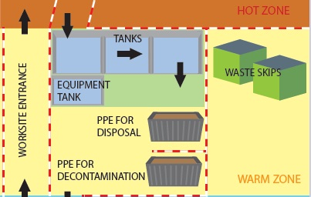
Typical Decon Layout
Source: OSRL
CGPRT(W) : Ensuring Clean Seas and Coasts in Western Region ……

Slide 6
Post-Incident Operations
Operational tasks for field personnel:
  Ensure all equipment is removed from work sites;
    Identify equipment for repairs or to be replaced;
    Ensure it is returned to the appropriate location;
  Ensure equipment is cleaned up to the appropriate level;
    If another spill happens, equipment can be used without problems;
  Ensure all waste is removed from worksite.
    Oil, debris, PPE, food items, etc.
CGPRT(W) : Ensuring Clean Seas and Coasts in Western Region ……

Slide 7
Post-Incident Operations
Administrative tasks
  A number of administrative tasks must be completed once active clean-up is terminated.
  Typical administrative tasks at the operational level are:
    Finalize personnel and equipment usage timesheets
    Conduct incident debriefing with response personnel
    Participate in wider incident debrief
    Identify and implement lessons learned
    Amend operational procedures, if appropriate
    Contribute to incident report
CGPRT(W) : Ensuring Clean Seas and Coasts in Western Region ……

Slide 8
Post-Incident Operations
Post-spill studies
  Undertaken as necessary to:
    determine the nature and extent of damage;
    assess and monitor the recovery processes.
  Typically, post spill studies will start during response and continue after operations are concluded.
Post-spill monitoring must answer specific questions such as:
  For example, what are the levels of contaminants in the environment?
CGPRT(W) : Ensuring Clean Seas and Coasts in Western Region ……

Slide 9
Post-Incident Operations
Post-spill studies – field perspective
  It is possible that some activities related to post-spill studies will take place while workers are on site. In this case:
    Accommodate teams visiting sites (only if safe)
    Try not to interfere with sampling material/sites left on beaches
    Provide logistical support as required.
CGPRT(W) : Ensuring Clean Seas and Coasts in Western Region ……

Slide 10
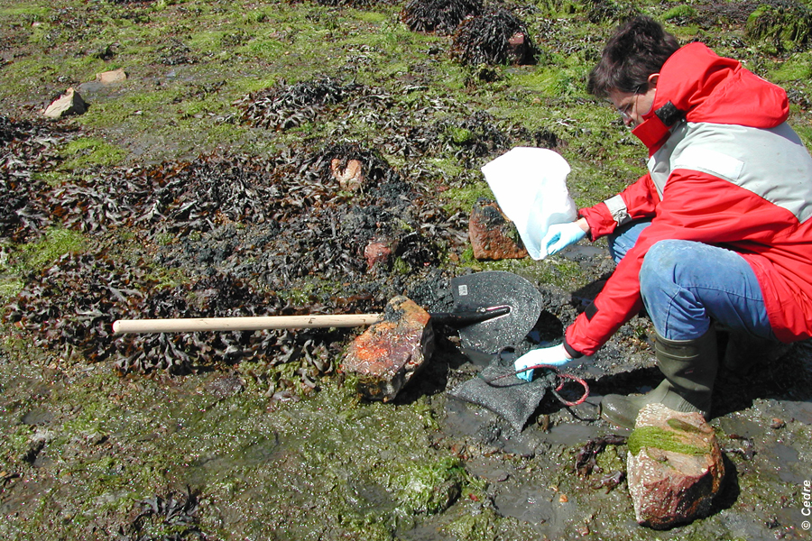
Sampling
Source: CEDRE
CGPRT(W) : Ensuring Clean Seas and Coasts in Western Region ……

Slide 11
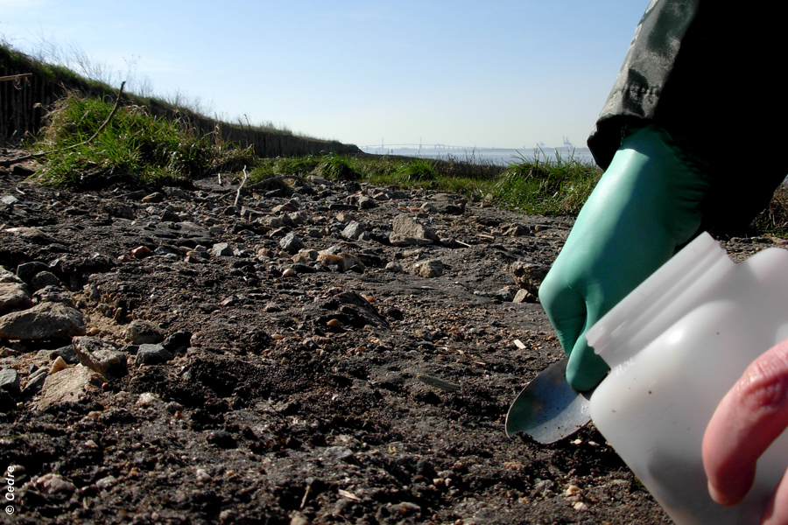
Sampling
Source: CEDRE
CGPRT(W) : Ensuring Clean Seas and Coasts in Western Region ……

Slide 12
Post-Incident Operation
Restoration
  Measures to speed up recovery from environmental damages.
  Aim to bring back environmental function to what it was prior to a spill.
  Various methods:
    Planting (mangroves, marshes)
    Restricting access to particular habitat
    Predator control
CGPRT(W) : Ensuring Clean Seas and Coasts in Western Region ……

Slide 13
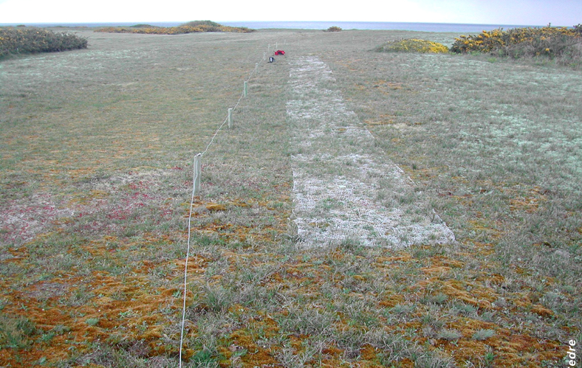
Restoration
Source: CEDRE
CGPRT(W) : Ensuring Clean Seas and Coasts in Western Region ……

Slide 14
Conclusion
Many tasks must be undertaken after active clean-up to terminate an oil spill response.
It is important to plan for those during the response and to keep resources available.
CGPRT(W) : Ensuring Clean Seas and Coasts in Western Region ……

Slide 15
Any questions?
CGPRT(W) : Ensuring Clean Seas and Coasts in Western Region ……

